Slide 1
BUDGET CONSTRAINT

Slide 2
Introduction
Economists assume that consumers choose the best bundle of goods they can afford. Now, we have to describe more precisely what we mean by “best” and what we mean by “can afford.
In real life there are many goods to consume, but for our purposes it is convenient to consider only the case of two goods, since we can then depict the consumer’s choice behaviour graphically.
We will indicate the consumer’s consumption bundle by (x, y). This is simply a list of two numbers that tells us how much the consumer is choosing to consume of good 1, x, and how much the consumer is choosing to consume of good 2, y.

Slide 3
We suppose that we can observe the prices of the two goods, (p₁, p₂) and the amount of money the consumer has to spend, m. Then the budget constraint of the consumer can be written as
p₁x + p₂y ≤ M
The consumer’s affordable consumption bundles are those that don’t cost any more than m. We call this set of affordable consumption bundles at prices (p₁, p₂) and income m the budget set of the consumer.
Two goods are often enough

Slide 4
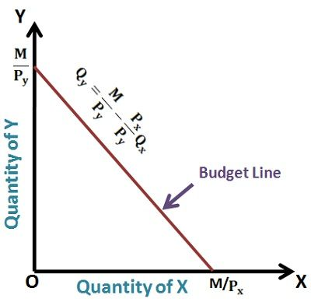
Budget line
The budget line is the set of bundles that cost exactly M

Slide 5
Slope of the budget line
The slope of the budget line has a nice economic interpretation. It measures the rate at which the market is willing to “substitute” good x for good y.
The slope of the budget line measures the opportunity cost of consuming good 1. In order to consume more of good x you have to give up some consumption of good y. Giving up the opportunity to consume good y is the true economic cost of more good x consumption; and that cost is measured by the slope of the budget line.

Slide 6
How the budget line changes?
First consider changes in income. An increase in income will increase the vertical intercept and not affect the slope of the line. Thus an increase in income will result in a parallel shift outward of the budget line.
Now consider changes in prices. Increasing p₁ will not change the vertical intercept, but it will make the budget line steeper since p₁/p₂ will become larger.

Slide 7
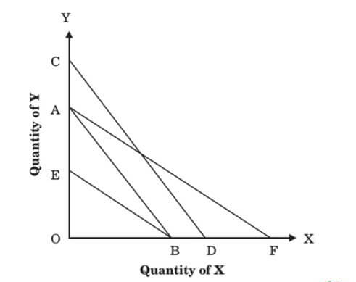
Shifts due to income and price changes

Slide 8
What happens to the budget line when we change the prices of good 1 and good 2 at the same time? Suppose for example that we double the prices of both goods 1 and 2. In this case both the horizontal and vertical intercepts shift inward by a factor of one-half, and therefore the budget line shifts inward by one-half as well. Multiplying both prices by two is just like dividing income by 2.

Slide 9
What if income decreases and prices increase?
If m decreases and p₁ and p₂ both increase, then the intercepts m/p₁ and m/p₂ must both decrease. This means that the budget line will shift inward.
What about the slope? If price 2 increases more than price 1, so that −p₁/p₂ decreases (in absolute value), then the budget line will be flatter; if price 2 increases less than price 1, the budget line will be steeper.

Slide 10
Taxes
Economic policy often uses tools that affect a consumer’s budget constraint, such as taxes. For example, if the government imposes a quantity tax, this means that the consumer has to pay a certain amount to the government for each unit of the good he purchases.
From the viewpoint of the consumer the tax is just like a higher price. Thus a quantity tax of t rupees per unit of good 1 simply changes the price of good 1 from p₁ to p₁ + t. This implies that the budget line must get steeper.
Another kind of tax is a value tax. As the name implies this is a tax on the value—the price—of a good, rather than the quantity purchased of a good. A value tax is usually expressed in percentage terms.

Slide 11
If good 1 has a price of p₁ but is subject to a sales tax at rate τ, then the actual price facing the consumer is (1 + τ )p₁. The consumer has to pay p₁ to the supplier and τp1 to the government for each unit of the good so the total cost of the good to the consumer is (1 + τ )p₁
A subsidy is the opposite of a tax. In the case of a quantity subsidy, the government gives an amount to the consumer that depends on the amount of the good purchased. If, for example, the consumption of milk were subsidized, the government would pay some amount of money to each consumer of milk depending on the amount that consumer purchased. If the subsidy is s rupees per unit of consumption of good 1, then from the viewpoint of the consumer, the price of good 1 would be p₁−s. This would therefore make the budget line flatter.
Similarly an ad valorem subsidy is a subsidy based on the price of the good being subsidized.

Slide 12
Another kind of tax or subsidy that the government might use is a lump sum tax or subsidy. In the case of a tax, this means that the government takes away some fixed amount of money, regardless of the individual’s behavior.
Thus a lump-sum tax means that the budget line of a consumer will shift inward because his money income has been reduced. Similarly, a lump-sum subsidy means that the budget line will shift outward.

Slide 13
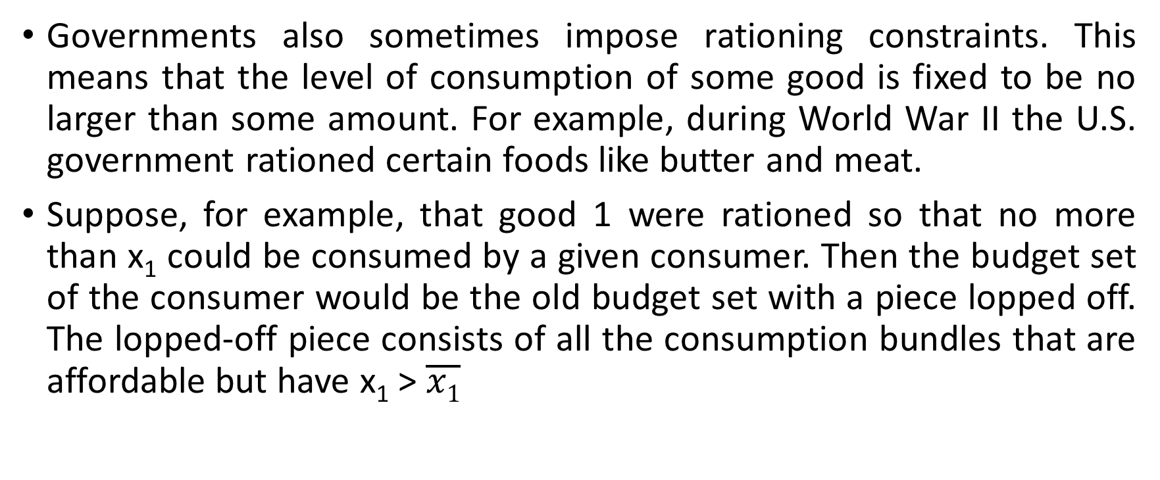
Rationing
Governments also sometimes impose rationing constraints. This means that the level of consumption of some good is fixed to be no larger than some amount. For example, during World War II the U.S. government rationed certain foods like butter and meat.
Suppose, for example, that good 1 were rationed so that no more than x₁ could be consumed by a given consumer. Then the budget set of the consumer would be the old budget set with a piece lopped off. The lopped-off piece consists of all the consumption bundles that are affordable but have x₁ > $\overline{x1}$

Slide 15
Sometimes taxes, subsidies, and rationing are combined. For example, we could consider a situation where a consumer could consume good 1 at a price of p₁ up to some level x₁, and then had to pay a tax t on all consumption in excess of x₁.
Here the budget line has a slope of −p₁/p₂ to the left of x₁, and a slope of −(p₁ + t)/p₂ to the right of x₁.

